Slide 1
Heuristic Search 2
Optimisation Methods

Slide 2
Contents
Hill Climbing
Random Mutation Hill Climbing
Random Restart Hill Climbing
Stochastic Hill Climbing
Genetic Algorithm
Others
Simulated Annealing
Ant Colony

Slide 3
Hill Climbing
Hill Climbing (HC) algorithm is an iterative search method that aims to find a point in the search space that maximises some objective function (fitness)
The HC algorithm starts off at some random point in the search space
It then looks randomly at its close neighbours until it find one with a better fitness
The hill climbing algorithm then continues searching for improvement from this new point

Slide 4
Hill Climbing
The idea is that the algorithm locates points that lead up (or down) a slope in the fitness space
This is rather like the analogy of a hill walker trying to climb up a hill in the fog
They feel around themselves until they find a nearby direction that goes up
They then move to this higher point and continue searching
There are three types of HC:
Random Mutation Hill Climbing (RMHC)
Random Restart Hill Climbing (RRHC)
Stochastic Hill Climbing (SHC)

Slide 5
Hill Climbing
For RM Hill Climbing we need:
A random starting point
A small change
How many iterations we run the algorithm for

Slide 6
Hill Climbing - RMHC
The RM Hill Climbing algorithm is as follows:
Algorithm 1. RMHC(ITER)
Input: ITER- the number of iterations to run for
1) Let S be a random point in the search space,
let F be its fitness
2) For i = 1 to ITER (number of iterations)
3) Let S’ be a random point close to S,
Let F’ be its fitness
4) If F’ is better than F Then
5) Let S = S’ and Let F = F’
6) End If
5) End For
Output: S- a solution

Slide 7
Hill Climbing - SHC
We need to improve RMHC to escape local optima
We can do this by letting the algorithm accept worse fitness function values during its search
This is the basis of the Stochastic Hill Climbing (SHC) algorithm
The chance of accepting is a function of how bad the change is
A very bad change will have a small chance of being accepted
A slightly bad change will be accepted more often
There are many ways of doing this, the example decision function in the next slide is just one of these ways…

Slide 8
Hill Climbing - SHC
We accept (line 4 in the RMHC algorithm) a new solution according to the following equation:
Here:
f′ is the new fitness (line 3 in the RMHC algorithm)
f is the old fitness
T is a parameter (set to 25 for the 1,000 primes scales problem)
The correct choice of T can be very difficult...

Slide 9
Hill Climbing - SHC
A very effective version of the Hill Climbing algorithm is the Random Restart (RRHC) version
Here we run the normal RMHC algorithm a number of times and record the best
I.e. we start off in different sections of the search space
For example we might run it 10 times for 100 iterations rather than once for 1,000 iterations

Slide 10
Genetic Algorithm
Genetic Algorithms “mimic” evolution
Evolution is the change of a gene pool over time
A gene is a biological hereditary unit that is passed on (usually unaltered) for many generations
Genes are contained within the nucleus of a cell, within Chromosomes
Most organisms have multiple chromosomes

Slide 11
Genetic Algorithm
Genes mutate through random change
Individuals are selected/survive, through Natural Selection
Populations evolve and breed through recombination
The technique uses biological metaphors
Each gene is a binary digit
A chromosome is a single string of genes (Haploid)
A solution to a problem is encoded as a Chromosome
The encoding is called the representation
It must cover the whole search space
A Fitness Function is needed to rate how good a solution a chromosome represents

Slide 12
Population and Generations
An organism is a chromosome
The population is the number of chromosomes “alive” at any one time
The term generations is the number of times breeding has occurred

Slide 13
Crossover and Mutation
Two concepts are defined, which are referred to as Genetic Operators
Crossover
This is analogous to recombination or breeding
Typically, genetic material from two parents are combined to create children
Mutation
This is analogous to biological mutation
Genes are randomly changed

Slide 14
Mutation
Each bit (gene) of a chromosome is given a chance (probability) MP of inverting
A ‘1’ becomes a ‘0’
A ‘0’ becomes a ‘1’
01101101
00101111
(These ones)

Slide 15
Crossover
Crossover is a process to exchange the genes from parents to produce 2 children (potential solutions)
Parents (A and B) are the best solutions in the population used to produce children
Children (C and D) get some of the genes from A and B
Crossover techniques can be one point or uniform

Slide 16
Crossover - Example
Parent 1
Parent 2
P1
P1
P1
P1
P1
P1
P1
P1
P1
P1
P2
P2
P2
P2
P2
P2
P2
P2
P2
P2
One Point
Uniform
Child 1
P1
P1
P1
P1
P1
P1
P2
P2
P2
P2
P2
P2
P1
P2
P1
P1
P1
P1
P2
P1
P2
P2
P2
P2
P2
P2
P1
P1
P1
P1
P1
P1
P2
P1
P2
P2
P2
P2
P1
P2

Slide 17
GAs - Parameters
NG Number of Generations
PS Population Size
CP Crossover Probability
MP Mutation Probability
n The number of bits (genes) making
up each Chromosome

Slide 18
Simulated Annealing (SA)
Simulated Annealing is a stochastic global search optimization algorithm.
The algorithm is inspired by annealing in metallurgy where metal is heated to a high temperature quickly, then cooled slowly, which increases its strength and makes it easier to work with.
It allows a worse solution to be accepted so that local maximums can be circumnavigated

Slide 19
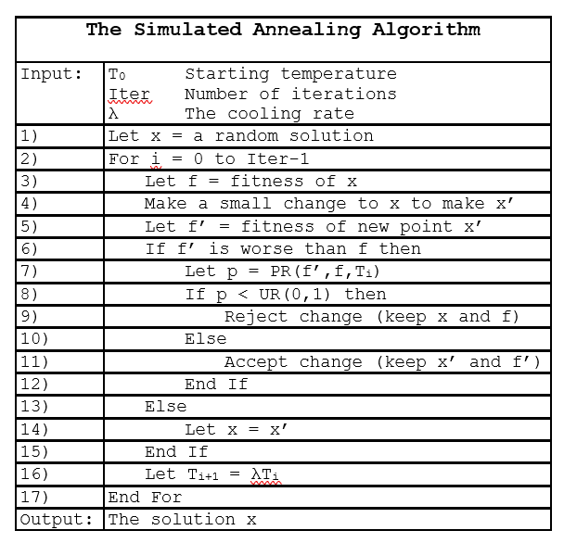

Slide 20
Ant Colony
Introduction to Ant colony optimization(ACO) | by Awan-Ur-Rahman | Towards Data Science

